Slide 1
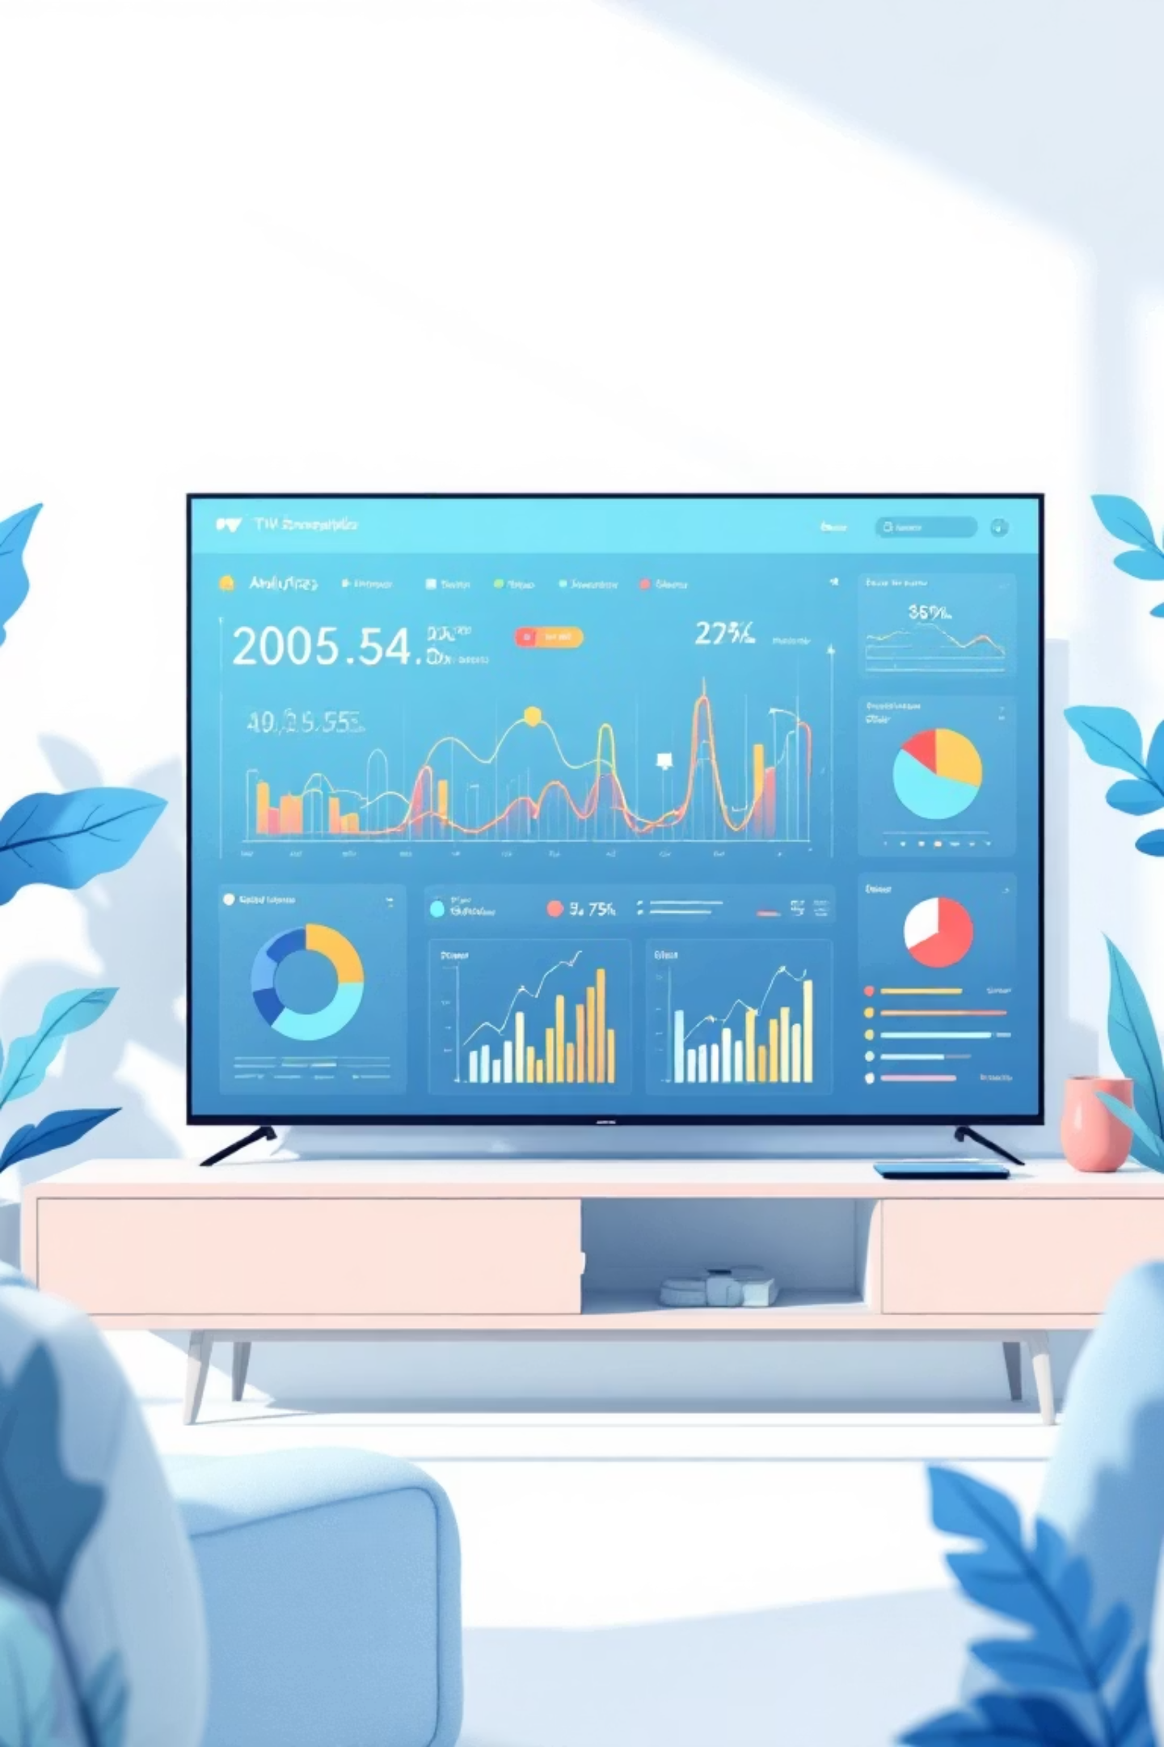
BrightTV Viewership Analytics
Unlocking Growth Opportunities
Transforming viewer data into actionable strategies to drive subscription growth and engagement

Slide 2
Our Mission & Roadmap
01
02
03
Analyze User Trends
Identify Key Factors
Strategic Recommendations
Examine 10,000 viewer records to understand consumption patterns and identify growth opportunities
Explore demographics, geographic distribution, and content preferences driving engagement
Develop targeted initiatives to boost subscription growth and optimize content strategy
Today we'll transform viewer data into clear, actionable strategies that directly support our CEO's subscription growth objectives.

Slide 3

Scale & User Activity Overview
10K
10.4B
Total Records
UserID Volume
Comprehensive viewer activity dataset
Massive scale of user engagement
Our analysis reveals consistent user activity over time with seasonal fluctuations that present optimization opportunities. The scale demonstrates BrightTV's significant viewer base and engagement potential.

Slide 4

Channel Performance Leaders
Supersport
Trace TV
Top-performing sports content driving highest engagement and viewing duration
Music entertainment capturing significant audience share and retention
Cartoon Network
Family-friendly content with strong consistent viewership patterns
These top channels reveal clear viewer preferences for sports, music, and family entertainment - key insights for content acquisition and marketing focus.

Slide 5



Critical Data Quality Challenge
79.8%
20.2%
Missing User Names
Complete Profiles
Significant data gap limiting personalization capabilities
Users with name data available for targeting
This represents our biggest opportunity: improving data collection will unlock personalized experiences and targeted marketing that drives subscription growth.

Slide 6

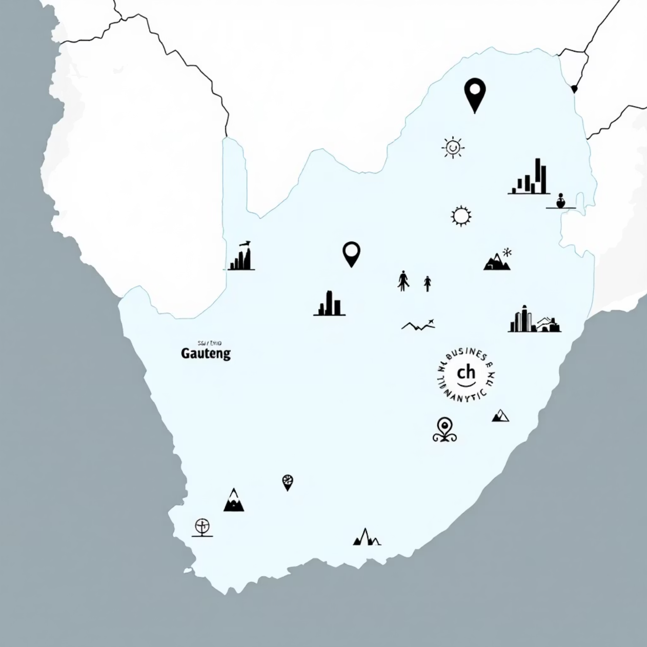

Geographic Concentration
75%
Gauteng Province
Dominant viewer concentration
25%
Other Provinces
Growth expansion opportunity
Gauteng's dominance presents a clear opportunity for targeted marketing campaigns and localized content strategies to maximize our strongest market.

Slide 7



High-Engagement Content Insights
Supersport Live
Channel O
ICC Cricket World Cup
Longest viewing duration indicating high engagement and retention potential
Strong music content performance driving consistent viewer loyalty
Premium sports events creating peak engagement and subscription drivers
These high-duration channels demonstrate that sports and music content are key subscription drivers, warranting increased investment and promotion.

Slide 8

Content Strategy for Low-Activity Periods
Promote High-Duration Content
1
During low-activity days, feature Supersport, Channel O, and ICC Cricket content prominently
Gauteng-Targeted Campaigns
2
Run location-specific promotions to capitalize on our strongest market concentration
Event-Driven Programming
3
Schedule special events and releases around sports matches and music premieres

Slide 9
Growth Initiative Roadmap
Data Quality Enhancement
1
Implement user profile completion incentives and streamlined registration to address the 79.8% missing name issue
2
Content Acquisition Focus
Invest in sports and music genres, particularly premium live events that drive highest engagement
Personalization Engine
3
Develop recommendation system based on viewing history and power user behavior patterns
4
Strategic Partnerships
Forge exclusive content deals with Supersport and Trace TV to differentiate our platform

Slide 10

Driving Subscription Growth
Key Opportunities Identified
Geographic Focus: Leverage Gauteng's 75% concentration with targeted campaigns
Content Strategy: Double down on sports and music content proven to drive engagement
Data Enhancement: Improve user profiling to unlock personalization at scale
Power User Insights: Learn from high-activity viewers to optimize retention strategies
These data-driven insights provide a clear path to accelerate subscription growth through targeted content, improved personalization, and strategic market focus.

